Slide 1
Circulatory System

Slide 2
Function
The circulatory system transports substances including oxygen, nutrients and wastes to and from cells by diffusion (from high to low concentration along concentration gradient).

Slide 3
Multicellular Needs
Unicellular organisms don’t need a circulatory system, because the cell is in direct contact with the environment and oxygen, nutrients and wastes can easily diffuse across the cell membrane by diffusion.
Multicellular organisms need a circulatory system to transport substances made in one part of the body to sites where they are needed in another part of the body.

Slide 4
Circulation and Respiration
Working together, your circulatory and respiratory systems supply cells throughout the body with the nutrients and oxygen that they need to stay alive!

Slide 5
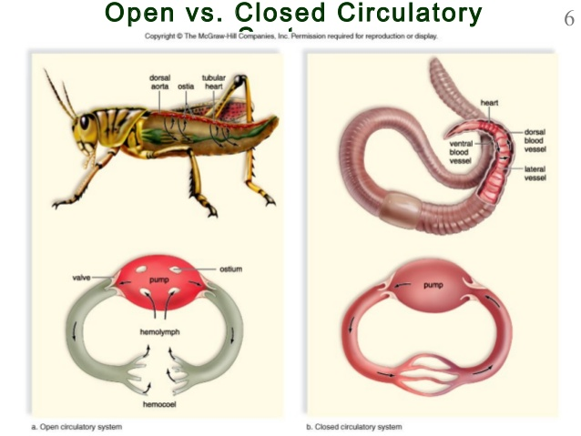
Structure
Humans have a closed circulatory system.
Sometimes the circulatory system is also called the “cardiovascular system” because:
Cardio = heart, Vascular = vessels

Slide 6
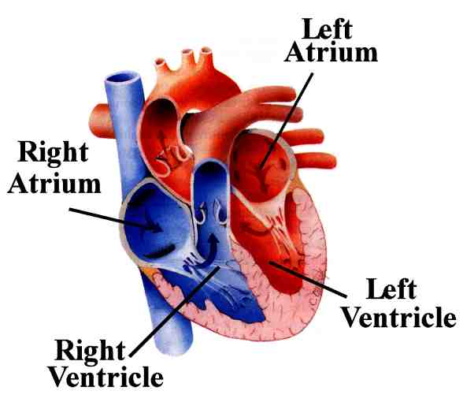
Heart
Flaps of connective tissue called valves divide each side into 2 chambers: totaling 4 chambers
Upper chambers receive blood = atrium
Lower chambers pump blood out of heart = ventricle
The heart contracts about 72 times a minute
Each contraction pumps about 70 mL of blood
Septum, or wall, separates the right side form the left side preventing mixing of oxygen-rich blood and oxygen-poor blood

Slide 7
Types of Circulation
Pulmonary circulation = from right side of the heart to lungs where carbon dioxide leaves the blood and oxygen is absorbed
Systemic circulation = from left side of the heart to organs
Coronary circulation = through heart tissue

Slide 8
Heartbeat
There are two muscle contractions in the heart:
The atria and The ventricles
When the atria contract, blood flows into the ventricles
When the ventricle contract, blood flows out of the heart
Your heart can beat faster or slower, depending on your body’s need for oxygen-rich blood
When you exercise, your heart rate can increase to 200 beats per minute
The autonomic nervous system influences heart rate (involuntary control)

Slide 9
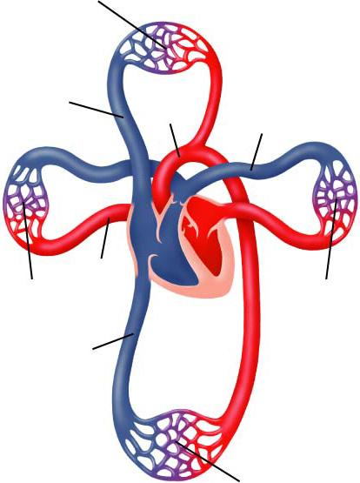


Figure 37-2 The Circulatory System
Section 37-1
Capillaries of head and arms
Superior vena cava
Aorta
Pulmonary artery
Pulmonary vein
Capillaries of right lung
Capillaries of left lung
Inferior vena cava
Capillaries of abdominal organs and legs
Blood leaves the heart through arteries, and blood returns to heart through veins

Slide 10
Blood vessels
Blood circulates in one direction and it is moved by the pumping of the heart
As blood flows through the circulatory system, it moves through three types of blood vessels:
Arteries
Capillaries
Veins

Slide 11
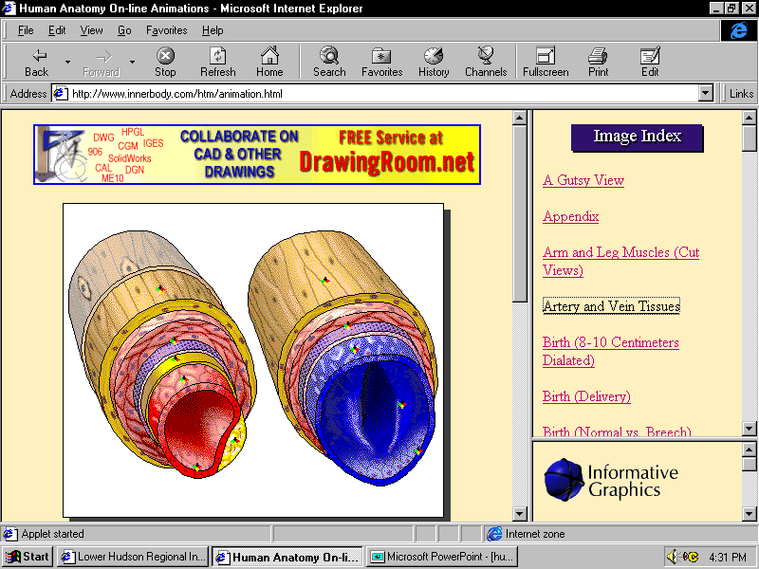
Arteries
Large vessels that carry blood away from the heart to tissues of the body
Except for the pulmonary arteries, all arteries carry oxygen-rich blood.
Arteries have thick walls of elastic connective tissue, contractible smooth muscle, and epithelial cells that help them withstand the powerful pressure produced when the heart contracts and pushes blood into the arteries.

Slide 12
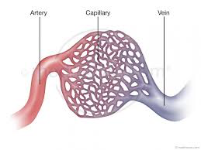
Capillaries
The smallest of the blood vessels connecting arteries and veins
Walls are one cell thick allowing for easier diffusion of nutrients and oxygen from capillaries to body cells and wastes and carbon dioxide from body cells to capillaries

Slide 13
Veins
Return blood to the heart
Veins have walls of connective tissue and smooth muscle
Large veins contain valves that keep blood flowing towards the heart
Many veins are located near skeletal muscles, so when the muscles contract, they help force blood through the veins, even against gravity
Exercise helps prevent accumulation of blood in limbs and stretching veins out of shape

Slide 14
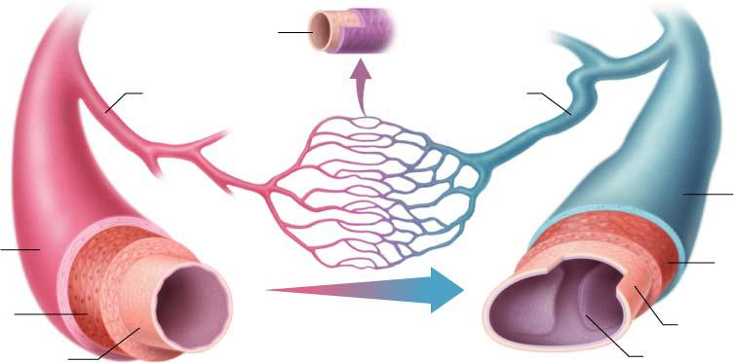
Figure 37-5 The Three Types of Blood Vessels
Section 37-1
Artery
Vein
Endothelium
Capillary
Arteriole
Venule
Connective tissue
Connective tissue
Smooth muscle
Smooth muscle
Endothelium
Endothelium
Valve

Slide 15
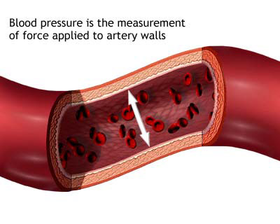
Blood Pressure
The heart produces pressure when it contracts.
The force of blood on the arteries’ walls = blood pressure
Blood pressure decreases when the heart relaxes, but there must always be some pressure to keep the blood flowing
Doctors measure blood pressure with a sphygmomanometer recording two numbers
Systolic pressure = force felt in arteries when ventricles contract
Diastolic pressure = force of blood felt in arteries when ventricles relax
Average adult’s blood pressure = 120/80

Slide 16
Regulating Blood Pressure
With the nervous system:
Sensory neurons at several places in the body detect blood pressure and send impulses to brain stem (medulla oblongata)
When too high, the autonomic nervous system releases neurotransmitters that cause the smooth muscles around blood vessels to relax, lowering blood pressure.
When too low, neurotransmitters are released that cause the smooth muscles to contract, elevating blood pressure.
With the endocrine/excretory system:
Hormones produced by the heart and other organs cause kidneys to remove more water from the blood when blood pressure is too high, reducing blood volume and lowering blood pressure

Slide 17
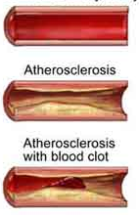
Disorders
Disorders of the circulatory system are very common:
High Blood Pressure
Heart Attack
Stroke
Most stem from atherosclerosis = fatty deposits (plaque) builds up on walls of arteries, obstructing blood flow, increasing blood pressure and risk of blood clots

Slide 18
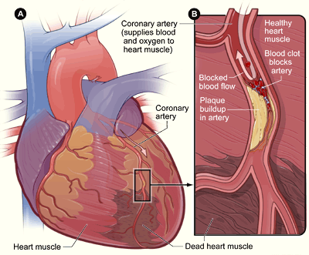
High Blood Pressure
Also known as Hypertension
Forces heart to work harder, which may weaken or damage the heart muscle and vessels
More likely to develop heart disease and increased risk of heart attack and stroke

Slide 19
Heart Attack
A medical emergency
Coronary arteries (supplying heart blood) bring oxygen and nutrients to the heart muscle itself
Blockage of coronary artery may damage or kill part of heart muscle (myocardium) due to lack of oxygen = heart attack
Symptoms include: chest pain/pressure, feeling of heartburn/indigestion, sudden dizziness, or brief loss of consciousness

Slide 20
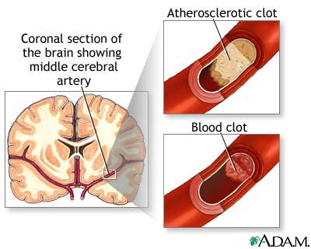
Stroke
Blood clots may break free from vessels and get stuck in a blood vessel leading to a part of the brain = stroke
Brain cells relying on that vessel may begin to die from lack of oxygen and brain function in that region may be lost
Strokes can also occur when a weakened artery in the brain burst, flooding the area with blood

Slide 21

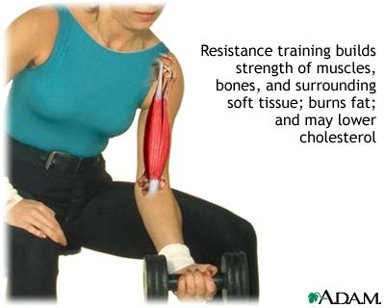
Prevention
Cardiovascular diseases are easy to prevent:
Exercise – increases respiratory system’s efficiency
Weight control – reduces body fat and stress
Sensible diet – low in saturated fat reduces risk of heart disease
Not smoking – reduces risk of heart disease

